Slide 1



Unlock Real-Time AI-ML
Event Streaming
with Spring and Cloud Native Data Services

Slide 2

introduction
Gregory Green
Principal Solution Architect
VMware By Broadcom

Slide 3
Goal
What is AI/ML?
Agenda
Technologies Spring & Data Services
Cloud Native Architecture
Conclusion

Slide 4
Goal
How can we understand information to make informed decisions quicker?

Slide 5

Information
Letter message content….

Slide 6
Is this information GOOD or BAD?
Is this Real?
Information
Letter message content….
Is this information dangerous?

Slide 7
Artificial
Intelligence
(AI)
Information
Letter message content….

Slide 8
What is Artificial Intelligence (AI)?
AI is technology that emulates human intelligence

Slide 9
What is Machine Learning (ML)?
ML is artificial intelligence that using mathematical data algorithms

Slide 10
AI
AI
Is this information GOOD or BAD?
Sentiment Analysis
Is this Real?
Fraud Detection
Information
Letter message content….
Is this information dangerous?
Threat Detection

Slide 11
Main Idea
AI
AI/ML can help humans to understand information to make informed decisions quicker using Models
ML

Slide 12
What is a Model?
Model is a Machine learning mathematically algorithm that is trained to produce an outcome
Model

Slide 13
Model algorithms are base supervised or unsupervised or reinforcement learning
How do Models learn?
Model
<Supervised>
Model
<reinforcement>
Model
<Unsupervised>
neural networks
decision trees
linear regression
hidden Markov
k-means
hierarchical clustering
Gaussian mixture
temporal difference
deep adversarial networks
Q-learning

Slide 14
AI Models Algorithm- categories
Classification
Classification is a ML model algorithm to group data by a category
Anomaly
Clustering is ML model algo algorithm to identify deviation for normal trends
Regression
Regression is ML model algorithm predict outputs
Clustering
Clustering is ML model algorithm to group similar points

Slide 15
Sentiment Analysis
Classification
Classification is a ML model algorithm to group data by a category
Fraud Detection
Information
Threat Detection
Letter message content….

Slide 16
Inferencing
Inferencing refers providing input to Model to produce an output based on training data
Information
Model
Output=Sentiment Analysis
Input=Letter message content….

Slide 17
Models are provided training data that is labeled, learned and provided reinforcement feedback predict to future outcome data patterns and trends
How are models trained?
Model
Example Supervised ML Training Data
Text: "I absolutely love The Chosen series! The messaging is incredible and it made me cry a couple of times." Sentiment: Positive
Text: "The grocery prices are so expensive. The cost of my favorites like fruits and chicken are so disappointing." Sentiment: Negative
Text: "I had a mixed experience at the restaurant. The food was good, but the service was very slow." Sentiment: Neutral
Text: "This book was for real! It had me shocked one minute and laughing the next." Sentiment: Positive
Text: "The customer support team was pretty rude. I cannot say I look forward to shopping there again." Sentiment: Negative

Slide 18

Large Language Models (LLM) supports multiple categories of usage and are trained on enormous amounts of data such as information from the Internet.
Model
LLM

Slide 19


Can I use existing models?
Online Platforms like OpenAI with ChatGPT and Hugging Face and others have make is easy to use the power AI in existing Models
ChatGPT
<unsupervised>
Model(s)
FREE!

Slide 20
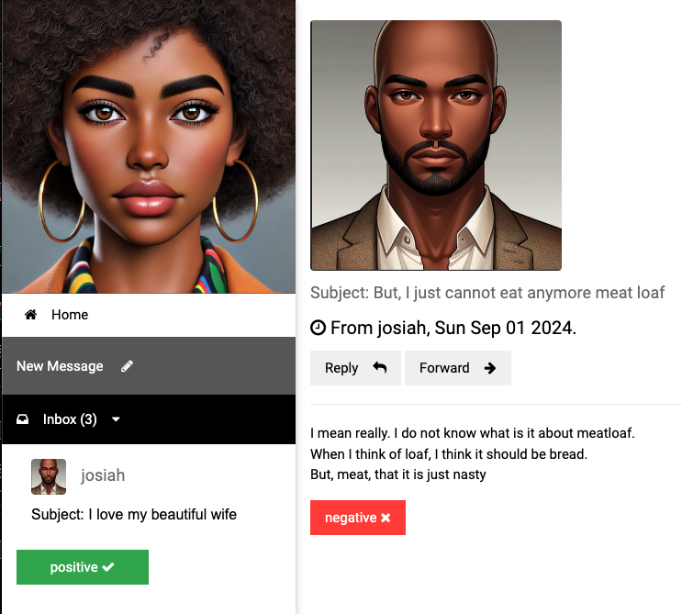
Sentiment Analysis

Slide 21
Getting started with AI/ML
Vector Embedding are a numerical representation of data
App(s)
=>
I love my awesome wife, she is my best friend
[ -0.5539689660072327, -0.04552192986011505, 0.2843276858329773, 0.12018735706806183, -0.4164251685142517, -0.0015744016272947192,
0.8378576636314392, -0.2455213963985443,
0.1919904500246048, 0.3389095067977905, 0.5132707357406616, -0.5949105024337769, -0.05128718167543411, 0.13099819421768188, 0.23817287385463715, 0.16531096398830414, -0.08132422715425491,,… ]

Slide 22
How are vector embeddings generated?
Text Embedding produces vector embedding based on text input
Model
<text-embedding>
App(s)
[ -0.5539689660072327, -0.04552192986011505, 0.2843276858329773, 0.12018735706806183, -0.4164251685142517, -0.0015744016272947192,
0.8378576636314392, -0.2455213963985443,
0.1919904500246048, 0.3389095067977905, 0.5132707357406616, -0.5949105024337769, -0.05128718167543411, 0.13099819421768188, 0.23817287385463715, 0.16531096398830414, -0.08132422715425491,,… ]
I love my awesome wife, she is my best friend
=>

Slide 23
How to perform sentiment analysis?
Model
<text-classification>
Model
<embedding>
App(s)
Text classification determine sentiment such as
-2=VERY_NEGATIVE, -1-NEGATIVE, 0=NEUTRAL,
1=POSITIVE 2=VERY_POSTIVE
Vector embedding
[ -0.5539689660072327, -0.04552192986011505, 0.2843276858329773, 0.12018735706806183, -0.4164251685142517, -0.0015744016272947192,
0.8378576636314392, -0.2455213963985443,
0.1919904500246048, 0.3389095067977905, 0.5132707357406616, -0.5949105024337769, -0.05128718167543411, 0.13099819421768188, 0.23817287385463715, 0.16531096398830414, -0.08132422715425491,,… ]
=>
=>
I love my awesome wife, she is my best friend

Slide 24

How to perform sentiment analysis?
Models
Spring AI
App(s)
Spring AI simplifies the use of ML models from libraries like Hugging Face and OpenAI for Java programing applications
I love my wife

Slide 25


How to receive data for sentiment analysis?
Event brokers provides real-time information event streaming
Spring AI
App(s)
Event
Broker

Slide 26
Why would you use RabbitMQ?
RabbitMQ streams can support millions of messages per second for inferencing
RabbitMQ streams can support replay messages for training
Event
Broker

Slide 27


How to store data?
Historical data that is the system of record operational data store
Database

Slide 28

How learn from stored data?
Model
LLM(s)
Vector databases integrate data for Large Language models LLM with similar data as context to provide better outcomes (also known as Retrieval Augmented Generation (RAG).
<Vector>
Database

Slide 29
How to learn from stored data?
Model
LLM(s)
<Vector>
Database

Slide 30

How to get results faster?
Provides fast access In-memory
most frequently used data information
Cache

Slide 31


Models
Models
Consumer Sink App
User
App
Event Processor
App
Data Services
Postgres ML
ValKey
RabbitMQ

Slide 32
Cloud Platform
Models
Models
Cloud platforms allow to easily scale AI/ML training and interference based on the volume of data and users
Event Processor
App
Consumer Sink App
User
App
Data Services
Postgres ML
RabbitMQ
ValKey

Slide 33



Cloud Native platforms
Cloud Native platforms like Kubernetes and Cloud Foundry simplify the deployment of applications and data services
Apps
Event
Broker
Cache
Database

Slide 34
Conclusion
Goal: How can we understand information to make informed decisions quicker?
AI/ML
Help use understand information based mathematically algorithm models
Spring
Simplifies the use of ML models for Java programing applications for inform outcome based decisions
Cloud Data Services
Cloud native platforms make is easy to run Event streaming brokers like RabbitMQ provides real-time information, Vector databases like Postgres to improve model accuracy and caching services like ValKey provide faster data access anywhere

Slide 35


Gregory Green
VMware By Broadcom
Connect with me on
Linked-In
Demo
Source
Code

